Slide 1
Global Humanitarian Aid
INFO 5100 – Application Engineering and Development
Rohan Magare
Prashant Sawale
Pranjal Maheshwari

Slide 2
Objective
In order to cooperate with each other , NGOs need to communicate with each other and make requests for different recourses that the NGOs have
The objective is to build such system, where NGOs create new projects which are to help war affected, homeless, poverty stricken people providing them basic necessities.
The funds , donations, donors are also to be managed by the system

Slide 3
Roles and responsibilities
System Admin Role:
Can create a new network of NGOs
Can Create an NGO
Can Create an Administrator for the created NGO
Creates a Communication line for all NGOs to respond for a request, each for a single project

Slide 4
Roles and responsibilities
NGO Administrator:
To create a certain type of department
Add employees or volunteers in certain department
Assign a user account and role within the department respectively.

Slide 5
Roles and responsibilities
Volunteer
Volunteer is of four types :
Chef(belongs to food department)
Teacher (belongs to education department)
Worker(belongs to any department)
Doctor(belongs to Medical department)
Each volunteer can login, view the list of projects they have assigned to , and update their profile (Address, phone number etc.)

Slide 6
How NGOs cooperate
When the NGO creates new project to address the certain kind of calamity, a new communication line is created and established , where he/she can request the recourses like funds or volunteers.
Every NGO is able to access the newly created communication line and able to respond to the requesting NGO with the recourses they have requested

Slide 7
How NGO maintains donations?
System provides a way for a donor to register to a certain NGO
Once NGO administrator provides user account to the donor, the donor will be able to log in to the system and make donations.

Slide 8
How does the NGO manage funds?

Slide 9
Charts to help Administrator Analyze the ….

Slide 10
Conclusion
This System will help coordinate NGOs to reach out to more needful people and provide all the basic necessities. With this model we can take up this task to global level.

Slide 11
So what is the information model for the product catalog?
Is it
Product
Catalog
Or
Product

Slide 12
Product catalog keeps track of products
Or
Catalog has products
Product
Catalog
Product
Relationship

Slide 13
Product catalog keeps track of products
Relationship connections give meaning to
concepts:
Product
Catalog
Catalog has products
Product
Product belongs to catalog

Slide 14
Product catalog keeps track of products (manages products)
Product
Catalog
Product
Product group info goes here
Product info goes here
Group specific and does not care about details of individual products: Its responsibilities include:
Creating new products
Add a product to the current list
Find and remove from the list
Find and update a specific product
Specific to a product like its price, avail, desc, etc.

Slide 15
Other Catalog Patterns (AKA factory pattern)
Catalog
Resource
Pattern
Example
Course
Catalog
Course
Car
Catalog
Car

Slide 16
How to implement this pattern in java?
Product
Catalog
Product
Define Java class for the product catalog
Define a java class for product
The product catalog class must keep track of products
How?

Slide 17
Why learning how to implement relationship connections are important?

Slide 18
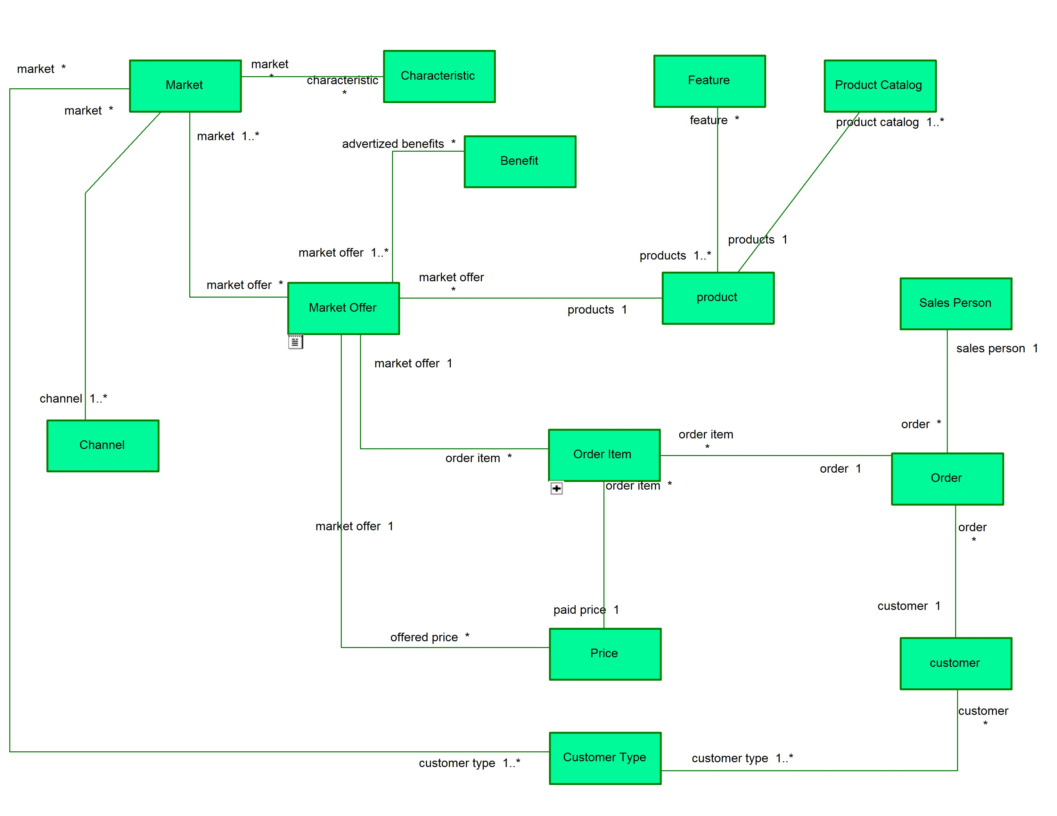

Slide 19
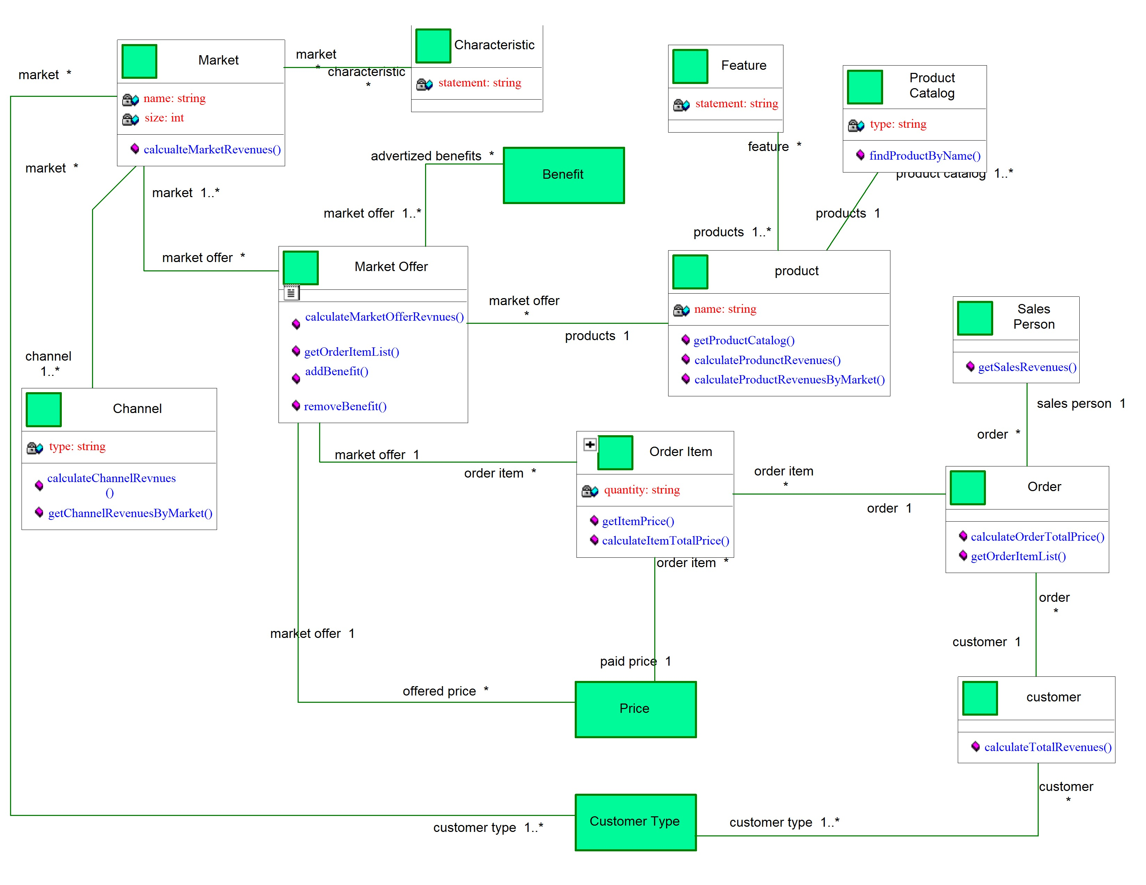

Slide 20
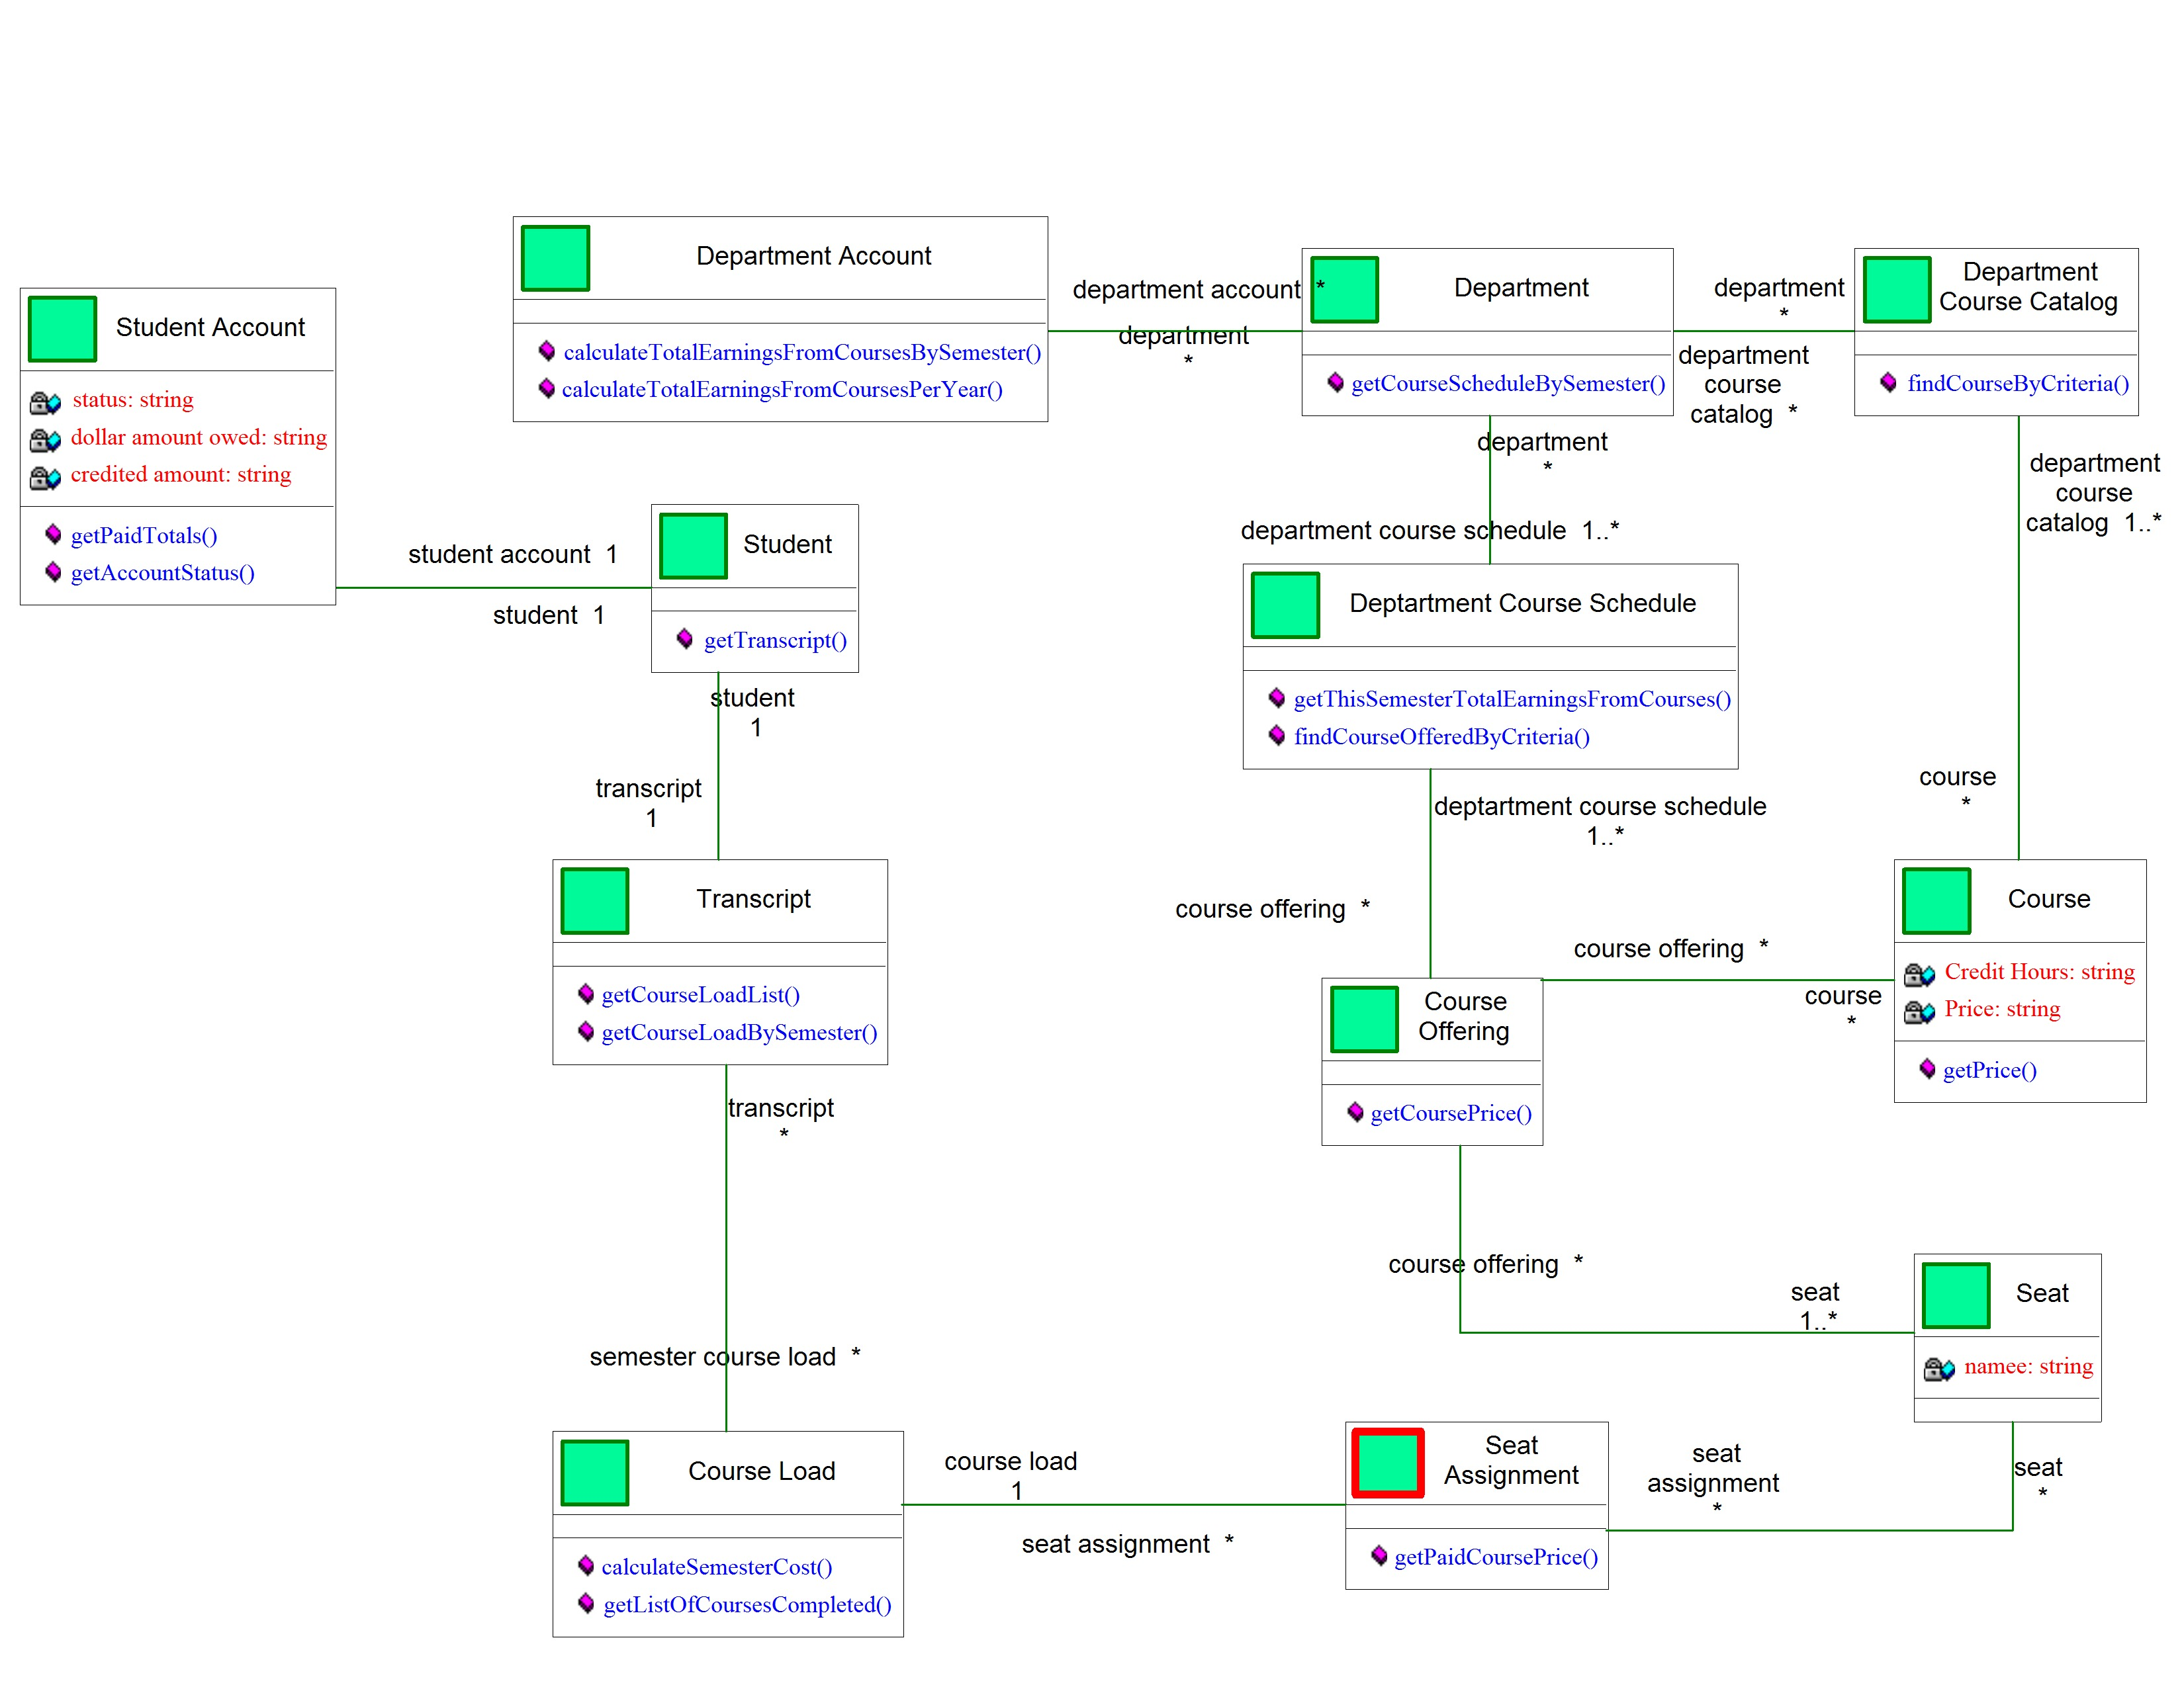
Department related questions start here
Student related questions start here

Slide 21
Create Product Class under the business package
Product
name
price
availability
description
Attribute
Method

Slide 22
ProductCatalog Class under the business package
ProductCatalog
name: String
lastUpdated: String
description: String
products: List of products
Attribute
newProduct(): returns a new empty product
FindProduct(ProductId:String)
getProductList(): returns list of all products
Method

Slide 23
ProductCatalog Class under the business package
ProductCatalog
The newProduct() method does the following:
Uses the java new operator to create a product object
Saves internally as part of a list
Returns the obejct to the caller (requester)
newProduct(): returns a new empty product

Slide 24
How the product catalog will flow through the screens?
When the mainjframe is first executed, we create an object of
type productcatalog
We keep the product catalog object in the MainJFrame for the
duration of the application
When user wants to add a product we send the product catalog
object to the add product screen
The product screen will use the product catalog object to
create new product and fill it with input from the user.
The catalog should how to save the newly created product in
its list of products

Slide 25
Create product catalog and save it here in a reference variable
Jframe (MainJFrame)
Product Catalog
Add Product JPanel
Product Catlog
Input fields
NameTextField
PriceTextField
Product
The product catalog object here is passed as a parameter from the MainJFrame (both are the same object)
Product

Slide 26
Create product catalog and save it here in a reference variable
Jframe (MainJFrame)
Product Catalog
View products JPanel
Product Catlog
Product
The product catalog object here is passed as a parameter from the MainJFrame (both are the same object)
Product 1
Product 2
Product 3
Product 4
Product

Slide 27
What is an ArrayList?
Allows you to keep a number of objects in one place
You can add object to the arraylist
arraylist.add(object)
You can remove objects
arraylist.remove(object)
Product 1
Product 2
Product 3
Product 4

Slide 28
How to declare and create an arraylist object?
private ArrayList <Product> productList;
ArrayList productList = new ArrayList();

Slide 29
How to create the catalog Object?
ProductCatalog userdir = new ProductCatalog();
Or
ProductCatalog productcatalog;
:
productcatalog = new ProductCatalog();

Slide 30
How to create a product and add the product to the catalog?
ProductCatalog productcatalog;
productcatalog = new ProductCatalog();
:
Product product = productcatalog.newProduct ();
Product.setName( “Laptop”);
:

Slide 31
How to access and traverse the product list?
object list
We use a for loop
for(ObjectType object: object list)
{
<Do something with object;>
}
a java class
Object 1
Object 2
Object 3
Object 4
1. Object 1
2. Object 2
3. Object 3
4. Object 4
5.
:

Slide 32
How to access and traverse the product list?
Reference variable to keep track of the productlist
productlist
ArrayList productlist;
productlist = productcatalog.getProductList();
for(Product p: productlist )
{
String name = p.getName();
<display name to the screen>
}
product 1
product 2
product 3
product 4
1. product 1
2. product 2
3. product 3
4. product 4
5.
:

Slide 33
Step 1: Open up the based project
You will build on top of that project

Slide 34
Step 2: Creating the Product Class
Define it under the Business Package

Slide 35
Step 3: Creating the ProductCatalog Class
The concept of a directory means a list of things, in this case it will be a list of Product objects
Now you will create a new Java class in the Business package called ‘ProductCatalog’
Right click on the Business package and select New → Java Class
Enter ‘ProductCatalog’ and select Finish

Slide 36
Step 4: Define the ProductCatalog attribute
Remember that attributes are the data holders (Data Structures) for a class. There are basically two main categories of attributes:
Primitive
Reference
Within these two categories lies different types of attributes
Strings
Integer
Array
Etc.
Define a Member variable to hold multiple Product objects
package Business;
// Include import statements ..
public class ProductCatalog
{
private ArrayList <Product> productList;
public ProductCatalog()
{
productList = new ArrayList();
}
}
Be aware that you may need to include some import statements here so the compiler knows where to reference the ArrayList and Product types (both are REFERENCE TYPES):
import Business.*;
import java.util.ArrayList;

Slide 37
Step 4: Define the ProductCatalog attribute (cont’d)
There is a new concept here:
Generics – Simply, generics act as enforcements so that a collection type (List, HashMap, ArrayList etc.) are populated by only one TYPE of class.
For example, it ensures that only objects of type Product are allowed to be added into the list.
The syntax to enforce a certain type is by using the ‘<ClassName>’ after the variable type but before the variable name
Ex. ArrayList <Product> nameOfProductCatalogVariable
The other interesting technique here is an instantiation of the ArrayList in the constructor
ArrayLists are reference types, so without instantiation we do not have a concrete object to work with
We place instantiation code in the constructor to ensure that the productCatalog variable is instantiated one time

Slide 38
Step 5: Build on the ProductCatalog class
Complete the getter/setter methods for your attribute
Be careful to return type ArrayList
The purpose of the ProductCatalog class is to hold multiple Product objects, right?
Let’s define a way to add Product objects into the productCatalog object.
We need to construct a new method to do this
..
public void addProduct(Product p)
{
productList.add(p);
}
..

Slide 39
Step 5: Build on the ProductCatalog class (cont’d)
The ProductCatalog class is responsible for managing numerous Product objects.
With this in mind, the ProductCatalog should also be capable of creating Product objects for us.
Create a new method.
..
public Product newProduct ()
{
Product p = new Product();
productList.add(p);
return p;
}
..
Notice that we are returning type Product. We will use this method to create new Product objects instead of directly instantiating them ourselves.
From now on, any time we need a Product object, we will ask the ProductCatalog class for one. This ensures that the Product is being managed.
ProductCatalog pc = new ProductCatalog();
Product product = pc.newProduct();
product.setName(“Oreo”);
..

Slide 40
Step 6: Congratulations, you have your ProductCatalog Class
package Business;
import Business.*;
import java.util.ArrayList;
public class ProductCatalog {
private ArrayList <Product> productList;
public ProductCatalog() {
productList = new ArrayList();
}
public ArrayList getProductCatalog(){
return productList;
}
public void setProductCatalog(ArrayList pList) {
productList = pList;
}
public Product newProduct() {
Product p = new Product();
productList.add(p);
return p;
}
public void addProduct(Product p){
productList.add(p);
}
}

Slide 41
Step 7: Edit the properties of the jTable
Open ViewProductCatalogJPanel, and see that the jTable is a child of the jScrollPane in the Inspector View
If you have noticed, the jTable comes with some default properties:
4 columns titled – Title 1, Title 2, Title 3, Title 4
4 empty rows
We do not want to keep these default settings, let’s tune the jTable to our needs.
Left click on the table
In the properties menu, hit “model” – it should be in bold
At the bottom, there is a place to edit the ‘Rows’ and ‘Columns’
Change the rows to 0, Change the columns to 3
We are selecting 3 columns:
1 column to hold the Product object and its name
1 column to hold the Product price data
1 columnt to hold the Product availability data

Slide 42
Step 7: Edit the properties of the jTable (cont’d)
Next, Double click on the first cell in the Title column – it should be already filled with ‘Title 1’
Replace ‘Title 1’ → ‘Product Name’
Replace ‘Title 2’ → Price
Replace ‘Title 3’ → Availability
Look at the column next to the Title column
The Type column is used to signify which type of object will be placed in the cell
The default is ‘Object’ and you will soon understand that everything in JAVA is of type object.

Slide 43
Step 8: Instantiate and Pass the ProductCatalog in JFrame
As of right now, you are passing a Product object, which is instantiated in the Jframe, to the AddProductJPanels and ViewProductCatalogJPanels
Remember that we said the ProductCatalog class was going to manage a number of Products for us. Therefore, instead of passing the Product object, we need to pass the ProductCatalog object
Open the Jframe in Source code mode
Edit the code to instantiate and pass the ProductCatalog instead of Product
..
public class MainJFrame .. {
private Product myProduct
= new Product();
public MainJFrame()
{
..
}
..
..
public class MainJFrame .. {
private ProductCatalog productCatalog;
public MainJFrame()
{
..
productCatalog = new ProductCatalog();
}
..
→

Slide 44
Step 8: Instantiate and Pass the ProductCatalog in JFrame (cont’d)
Now that you have instantiated a ProductCatalog
Next, you will need to pass the ProductCatalog
Simply, put the code in the actionEvent:
Do the same for the ‘ViewProductCatalogJPanel’ actionEvent
You will have compilation errors – this is okay, we still need to modify some additional code
..
AddProductJPanel apjp = new AddProductJPanel(productCatalog);
jSplitPane1.setRightComponent(apjp);
..

Slide 45
Step 9: AddProductJPanel
As of now, the AddProductJPanel is expecting a object of type Product to be passed into the constructor.
However, we would like to pass in the ProductCatalog because this will carry multiple Product objects for us
Put the code in AddProductJPanel
You will need to edit the member variable
You will need to edit the constructor parameter
Be sure to add any imports – you will need:
import Business.ProductCatalog;
private ProductCatalog productDir;
public AddProductJPanel(ProductCatalog pc)
{
initComponents();
this.productDir = pc;
}

Slide 46
Step 9: AddProductJPanel (cont’d)
Next, we need to edit the code that saved data from the UserInterface to the business object (Product)
We no longer have a Product object inside AddProductJPanel – instead we have a catalog that’s capable of creating them for us.
Goto the actionEvent code on the ‘Add Product’ button
Modify the code to:
Create a Product class
Populate that Product class
Everytime the actionPerformed event is triggered, a new Product object is created from the ProductCatalog and returned for manipulation.
If you remember, the newProduct() method in the ProductCatalog automatically adds the new Product to the list and returns a ‘copy’ or reference to it.
..
product.setName(nameField.getText());
product.setPrice(priceField.getText());
..
..
Product product = productCatalog.newProduct();
product.setName(nameField.getText());
product.setPrice(priceField.getText());
..
← You can reuse the code to retrieve data from the UserInterface, however, you need to first create a Product object with the same name as the Product object before

Slide 47
Step 10: ViewProductCatalogJPanel
Now that you have created the capability of creating multiple Products in the AddProductJPanel, you need a way to display all of the Product objects in the ProductCatalog.
The first step is to change the parameter of the ViewProductCatalogJPanel constructor to a ProductCatalog type
Previously, you didn’t have a member variable – so create one.
..
public ViewProductJPanel(Product product) {
initComponents();
nameLabel.setText(product.getName());
priceLabel.setText(product.getPrice());
}
..
Be sure to add any imports – you will need:
import Business.ProductCatalog;
private ProductCatalog productCatalog;
public ViewProductCatalogJPanel(ProductCatalog pc)
{
initComponents();
this.productCatalog = pc;
}

Slide 48
Step 10: ViewProductCatalogJPanel (cont’d)
Now that you have passed the ProductCatalog to the ViewProductCatalogJPanel, we can use the table to display the data.
Some of the syntax is going to be a bit mechanical – the advice is to study it and try to understand it
Create a new method in the class called ‘refresh’ (see next slide)

Slide 49
Step 10: ViewProductCatalogJPanel (cont’d)
private void refresh()
{
int rowCount =productTable.getRowCount();
int i;
for (i = rowCount-1; i >= 0; i--)
{
((DefaultTableModel)productTable.getModel()).removeRow(i);
}
ArrayList<Product> products = productCatalog().getProductCatalog();
for (Product p: products)
{
Object[] product_row = new Object[3];
product_row [0] = p;
product_row [1] = p.getPrice();
product_row [2] = p.getAvailability();
((DefaultTableModel)productTable.getModel()).addRow(product_row);
}
← This chunk of code will delete any rows currently in the table.
This chunk of code will go through all of the Product objects inside the ProductCatalog variable and do a few things:1 Create a new object with 3 slots
1 Create a new object with 3 slots
2 Populate the object with some data
3 Add the object as a row in the Table.
PLEASE TAKE TIME TO READ CODE

Slide 50
Step 10: ViewProductCatalogJPanel (cont’d)
Now that you have the refresh method created, you need to call it from the constructor of the ViewProductCatalogJPanel
..
public ViewProductCatalogJPanel(ProductCatalog pc)
{
initComponents();
this.productCatalog = pc;
}
..
..
public ViewProductCatalogJPanel(ProductCatalog pc)
{
initComponents();
this.productCatalog = pc;
refresh();
}
..

Slide 51
Step 10: ViewProductCatalogJPanel (cont’d)
Finally, You will need import statements that you are unaware of for the ViewProductCatalogJPanel:
..
import Business.*;
import javax.swing.table.DefaultTableModel;
import java.util.ArrayList;
..

Slide 52
Step 11: Fix any errors and Run
You have completed quite a bit of work.
Chances are, you probably have some errors
Go back to the classes that have errors and look at the error
If you have a “Cannot find symbol error” – I would check to see if you have all the import statements and make sure you have no Capitalization issues
Run the program
From the AddProductJPanel try to add multiple Products
Then, see if they are all displayed in the ViewProductCatalogJPanel

Slide 53
Step 12: Run the program
Congratulations, you have completed the lab!
If you still have issues after completeing the lab, contact the TA’s.

Slide 54
((DefaultTableModel)productTable.getModel()).addRow(product_row);

